Slide 1
Stock Data and Lagged Correlation
The Team
Saniya Saji
Milan George Mathew
Nibras Ul Haque
Group no.14
Project Guide
Suzen Saju

Slide 2
Contents
Background
The Problem statement
Literature Survey
Proposed Solution
Future Scope
Relevance

Slide 3
Background
Why are we here?
Uncover Hidden Relationships – Traditional methods may miss delayed stock interactions.
Enhance Market Insights – Identify how past stock movements influence others.
Improve Decision-Making – Supports better portfolio management and risk assessment.
Notes:
Concerning

Slide 4
Problem statement
Stock price prediction is challenging due to market volatility and complex patterns. This project leverages XGBoost and correlation analysis to improve trend forecasting, helping investors make informed decisions.

Slide 5
Literature Survey continuation
Where are researchers with this?
[1] Yifan Zhang, “Stock Price Prediction Method Based on XGboost Algorithm”, 2023, ICBBEM 2022, AHIS 5, pp. 595–603.
Advantages:
The XGBoost model effectively captures high-frequency time series fluctuations in stock prices.
It prevents overfitting using a regularization term.
Disadvantages:
High computational cost due to complex tree-based boosting structure.
Model performance depends on careful parameter selection and feature engineering..
Notes:
Functional resonance imaging (fMRI)
It measures brain activity. MRI measures brain structure.

Slide 6
Literature Survey
Where are researchers with this?
[2] A. User, "Lagged Correlation-Based Deep Learning for Directional Trend Change Prediction in Financial Time Series," 2025, pp. X-Y, doi: [doi-link].
Advantages:
Improves prediction accuracy using lagged correlations.
Offers valuable insights for financial trend forecasting.
Applicable to various stock market scenarios.
Disadvantages:
Requires large, high-quality datasets.
Computationally intensive.
Susceptible to overfitting with smaller or noisy datasets.
Notes:
Functional resonance imaging (fMRI)
It measures brain activity. MRI measures brain structure.

Slide 7
Literature Survey continuation
Where are researchers with this?
[3] T. Singh, R. Kalra, S. Mishra, S. & M. Kumar, "An efficient real-time stock prediction exploiting incremental learning and deep learning," Evolving Systems, vol. 14, pp. 919–937, Dec. 2022, doi: 10.1007/s12530-022-00487-2.
Advantages:
Easy to use
Cost-effective
Disadvantages:
Listening problems
Reliance on a constant web connection
Notes:
Functional resonance imaging (fMRI)
It measures brain activity. MRI measures brain structure.

Slide 8
Literature Survey continuation
Where are researchers with this?
[4] Pham Hoang Vuong et al., “Stock-Price Forecasting Based on XGBoost and LSTM”, 2022, Computer Systems Science and Engineering, Vol. 40, No. 1.
Advantages:
The combination of XGBoost for feature selection and LSTM for prediction improves forecasting accuracy.
Handles high-dimensional time-series data efficiently by selecting important features and removing redundancy.
Disadvantages:
High computational cost due to the integration of gradient boosting and deep learning.
Requires careful tuning of hyperparameters in both XGBoost and LSTM for optimal performance.
Notes:
Functional resonance imaging (fMRI)
It measures brain activity. MRI measures brain structure.

Slide 9
Literature Survey continuation
Where are researchers with this?
[5] Xizi Pan, “Stock Price Prediction System LSTM Based on Deep Learning”, 2024, Journal of Economics and Public Finance, Vol. 10, No. 4.
Advantages:
LSTM outperforms traditional models like Linear Regression, SVR, Decision Tree Regression.
Captures long-term dependencies effectively, reducing prediction errors.
Disadvantages
LSTM still struggles with highly volatile stocks like Tesla, leading to higher prediction errors.
Requires large amounts of historical data for accurate predictions.
Notes:
Functional resonance imaging (fMRI)
It measures brain activity. MRI measures brain structure.

Slide 10
Literature Survey continuation
Where are researchers with this?
[6] He Zhu, “Stock Prediction Using Artificial Intelligence Technology: A Review”, 2024, Proceedings of the 3rd International Conference on Financial Technology and Business Analysis.
Advantages:
AI models improve stock prediction accuracy by analyzing vast datasets.
Deep learning techniques detect complex market patterns better than traditional models.
Disadvantages:
AI-based stock prediction is sensitive to data quality and completeness.
Overfitting remains a challenge, leading to inaccurate predictions in real-world scenarios.
Notes:
Functional resonance imaging (fMRI)
It measures brain activity. MRI measures brain structure.

Slide 11
Literature Survey continuation
Where are researchers with this?
[7] Chang Liu & Sandra Paterlini, “Stock Price Prediction Using Temporal Graph Model with Value Chain Data”, 2023, University of Trento
Advantages:
LSTM-GCN model integrates spatial and temporal dependencies for improved stock prediction.
Captures complex relationships using Graph Convolutional Networks (GCN) and Long Short-Term Memory (LSTM).
Disadvantages:
Requires high-quality, well-structured value chain data for accurate predictions.
Computationally intensive due to graph-based learning and deep neural networks.
Notes:
Functional resonance imaging (fMRI)
It measures brain activity. MRI measures brain structure.

Slide 12
Literature Survey continuation
Where are researchers with this?
[8] Adeline Fellita Marwa et al., “Optimization of Stock Price Prediction with Ridge Regression and Hyperparameter Selections”, 2025, Jurnal Teknik Informatika (JUTIF), Vol. 6, No. 1.
Advantages:
Ridge regression with hyperparameter optimization improves stock price prediction accuracy.
Balances between prediction accuracy and computational efficiency.
Disadvantages:
Ridge regression assumes a linear relationship, which may not fully capture stock price fluctuations.
Requires careful tuning of hyperparameters for optimal performance.

Slide 13
Literature Survey continuation
Where are researchers with this?
[9] Ruiqi Zhao, “Stock Price Prediction Based on BP Neural Network and ARIMA Model”, 2024, Frontiers in Business, Economics and Management, Vol. 17, No. 1.
Advantages:
BP neural network and ARIMA improve stock price prediction accuracy.
ARIMA captures linear trends effectively, while BP neural network handles nonlinear patterns.
The combined model enhances prediction stability and reduces errors.
Disadvantages:
BP neural network requires extensive training data for optimal performance.
Computationally intensive, especially for large datasets.
Notes:
Functional resonance imaging (fMRI)
It measures brain activity. MRI measures brain structure.

Slide 14
Literature Survey continuation
Where are researchers with this?
[10] Siyuan Li, “Comparison of Machine Learning Models for Stock Prediction”, 2024, Proceedings of the 2nd International Conference on Management Research and Economic Development.
Advantages:
LSTM outperforms linear regression and KNN in Tesla stock prediction.
Captures complex patterns and long-term dependencies in stock prices.
Disadvantages:
Requires substantial data and high computational power.
Longer training time due to complex neural network structure.
Notes:
Functional resonance imaging (fMRI)
It measures brain activity. MRI measures brain structure.

Slide 15
Proposed Solution
Automated Stock Price Prediction
The system automatically analyzes multiple stock prices and their correlations using machine learning models. It identifies relationships between different stocks through lagged correlation analysis.
Real-Time Evaluation
The system processes user input instantly, applying XGBoost algorithms to predict stock prices. Users receive immediate feedback with comprehensive accuracy metrics and visualizations.
User-Friendly Interface
The web application built with Streamlit offers a simple interface for users to select stocks, date ranges, and model parameters. It provides interactive visualizations and detailed performance metrics.

Slide 16
Proposed Solution
Main Functionalities
Analyze Multiple Stocks Process and analyze multiple Indian stock tickers simultaneously using yfinance data.
Advanced Correlation Analysis Calculate lagged correlations between stocks to identify leading/lagging relationships.
Predictive Modeling Implement XGBoost with time series cross-validation and feature engineering.
Visual Analytics Generate interactive plots for price predictions, error analysis, and correlation heatmaps.

Slide 17
Implementation
Basic Workflow
User Input:
The user selects stock symbols or uploads a dataset. The system validates the input and ensures correct formatting.
Data Processing:
The backend retrieves and preprocesses stock data, aligns trading dates, and computes lagged correlations using the laggedCorr function.
Results Display:
The interface dynamically presents stock pairs, maximum correlations, and best lags, along with heatmaps and visual insights.
Notes:
Concerning

Slide 18
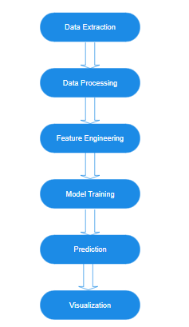
Implementation continuation
Methodology

Slide 19
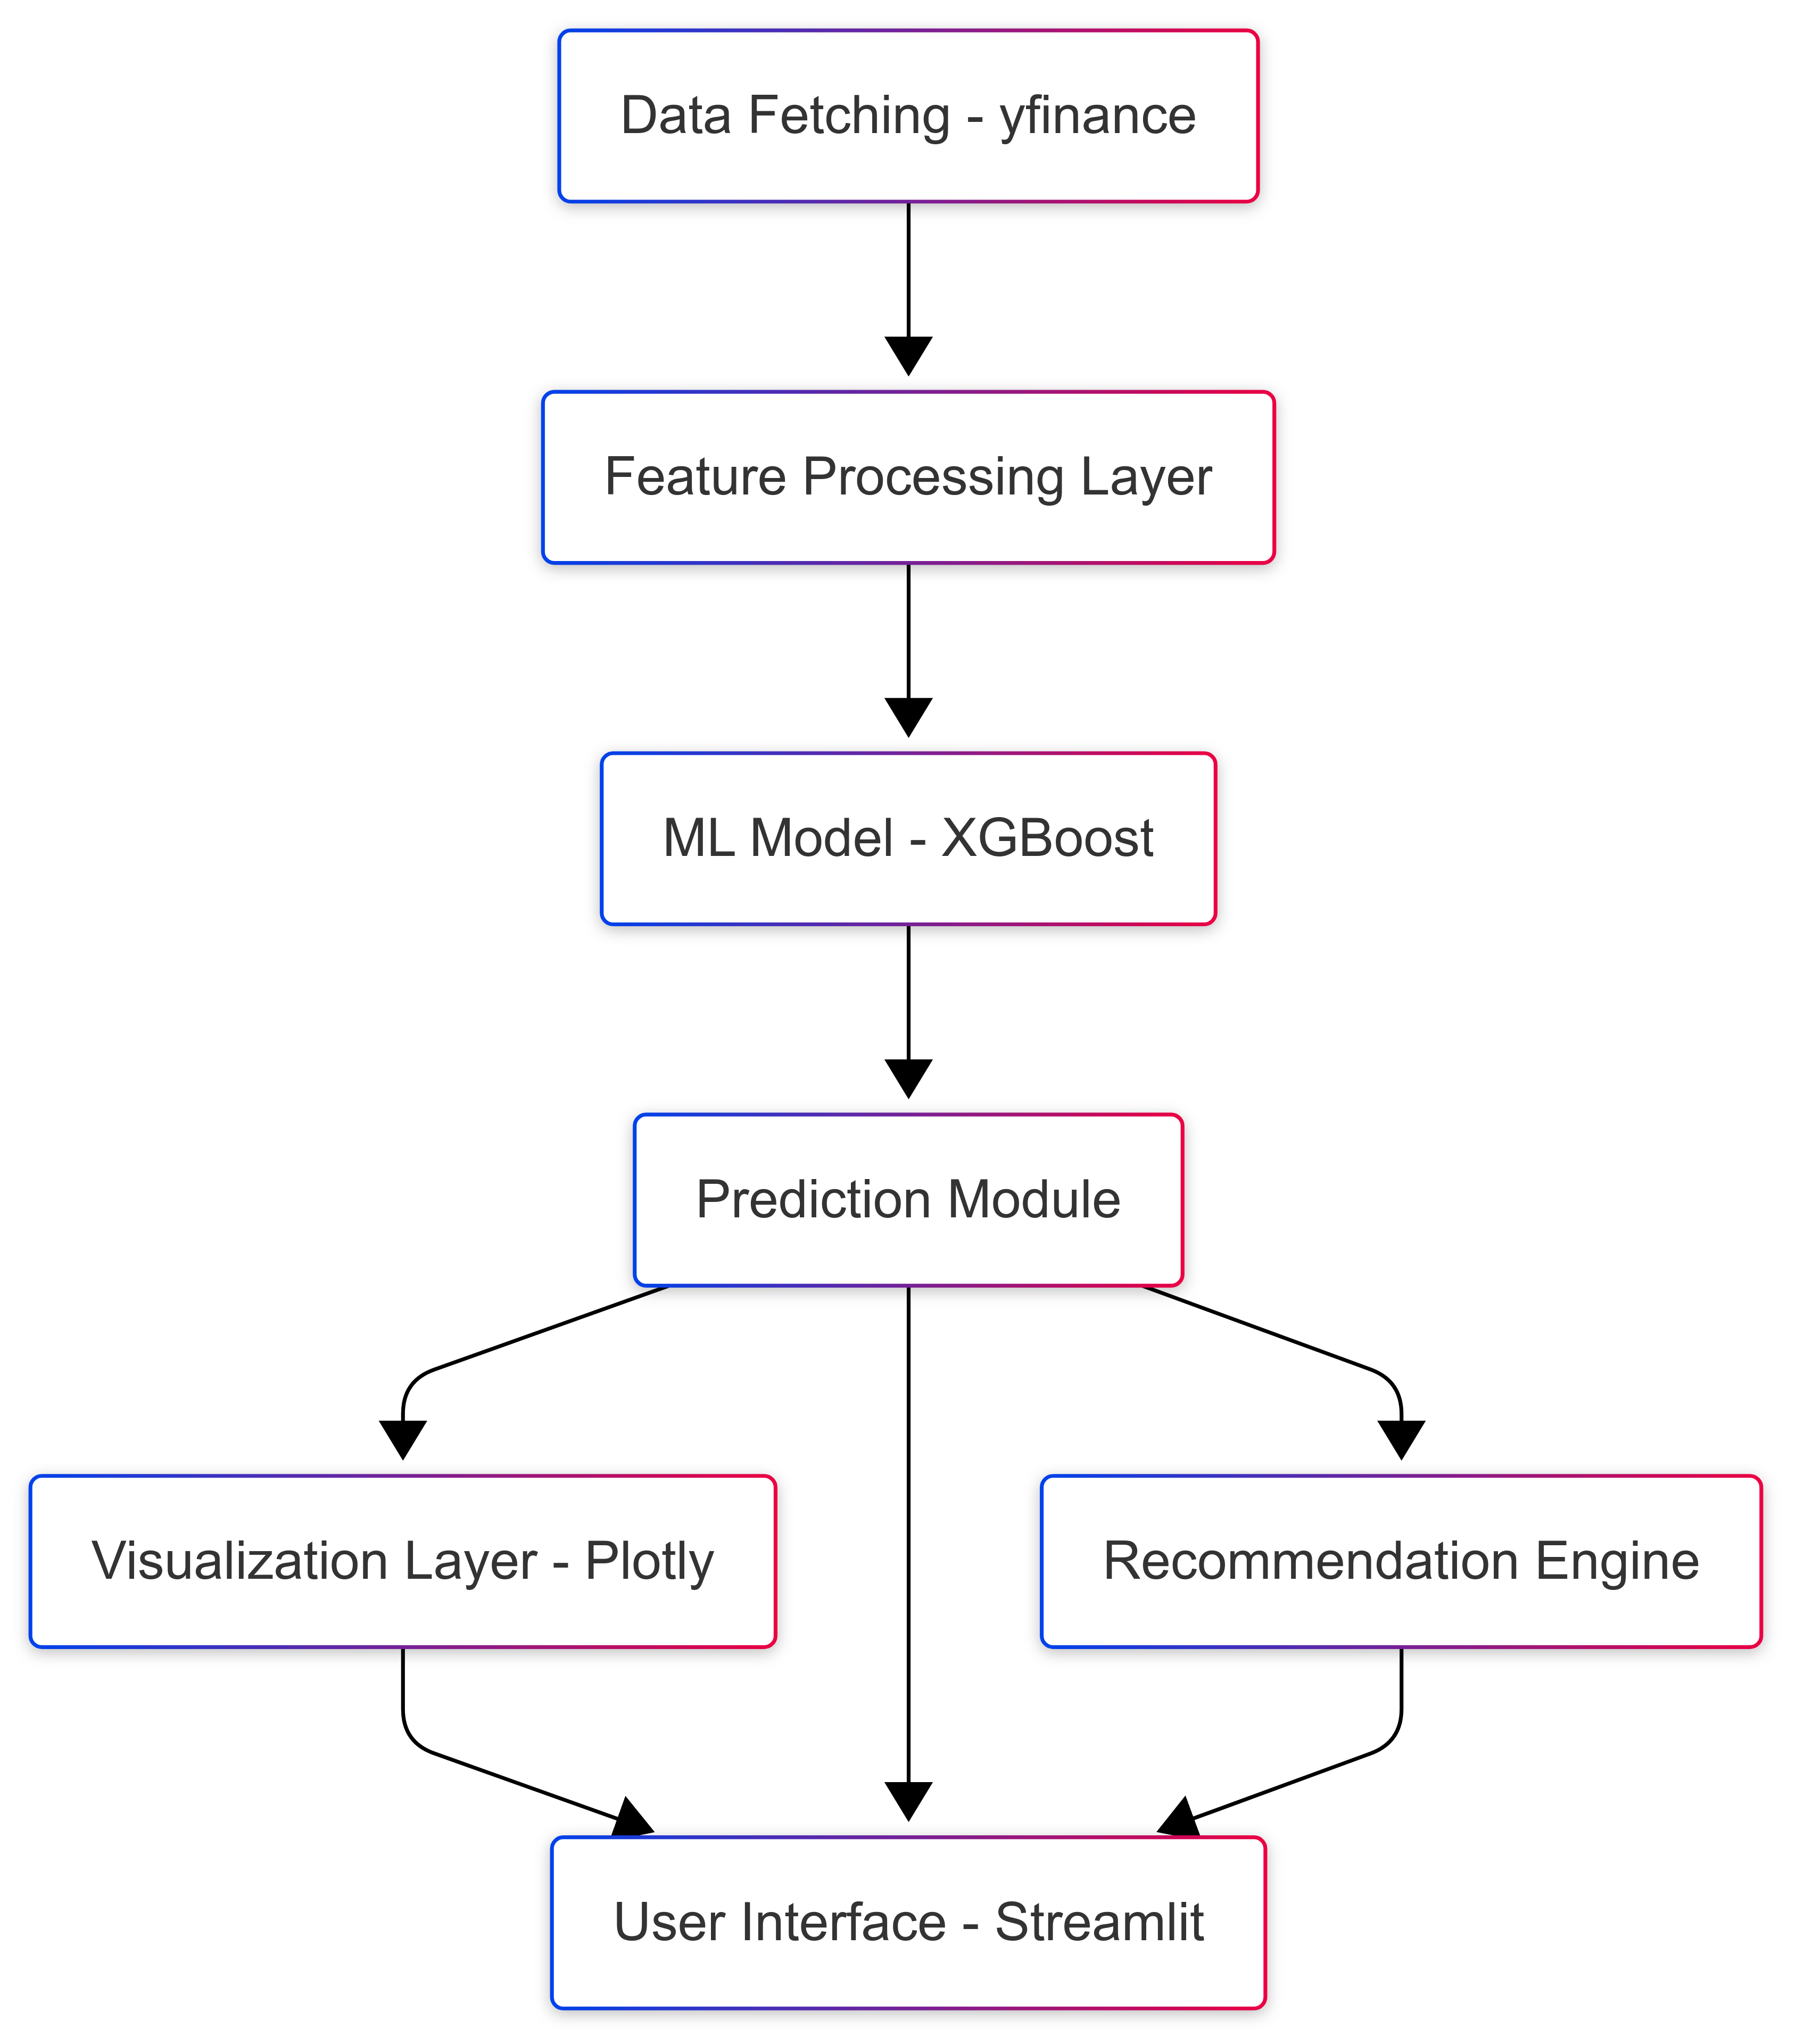
Implementation continuation
System Architecture
Frontend: Streamlit
Data Processing: pandas, numpy
Machine Learning: XGBoost, sklearn
Visualization: Plotly, Seaborn
Financial Data: yfinance API

Slide 20
Implementation continuation
Frontend development
For User Input:
✔ Allows users to select stock symbols or upload a dataset. ✔ Validates input to ensure correct stock symbols and data formatting.
Platform Used:
✔ Streamlit – Interactive UI for seamless stock correlation analysis. ✔ pandas, numpy – Data processing, handling missing values, and aligning trading dates. ✔ yfinance – Fetching real-time and historical stock price data. ✔ Plotly, Seaborn – Visualizing stock correlations with heatmaps and scatter plots. ✔ Fully coded solution for flexibility—no drag-and-drop interface.
Notes:
Concerning

Slide 21
Implementation continuation
Backend development
•Language used : Python
✔ General-purpose programming language. ✔ Used for data analysis, stock market predictions, and visualization. ✔ Simple and easy-to-use syntax
•Framework Used: Streamlit
✔ Lightweight framework for building interactive data applications ✔ Used to display stock analysis results with interactive visualizations ✔ Provides an intuitive UI for user input and data exploration
Notes:
Concerning

Slide 22
Implementation continuation
Backend development
•Model Training: Jupyter Notebook
✔ Used for developing and testing the stock correlation analysis. ✔ Provides an interactive environment for data visualization and debugging. ✔ Supports integration with Python libraries like NumPy, Pandas, and Seaborn
•IDE Used: VS Code
✔ Used to write and develop the Streamlit-based application. ✔ Supports Python programming and integration with financial data analysis libraries. ✔ Provides debugging tools for efficient code execution.
Notes:
Concerning

Slide 23
Implementation continuation
Packages and modules required:
Streamlit - Web framework for building interactive applications
XGBoost - Machine learning library optimized for gradient boosting
yFinance - Fetches real-time and historical stock market data
NumPy :- Numerical computation library for handling arrays and predictions
Seaborn - Statistical data visualization
Notes:
Concerning

Slide 24
Implementation continuation
Packages and modules required:
SciPy (stats) - Statistical functions for data analysis
Pandas - Data manipulation and analysis library
Datetime - Handles date and time operations
Notes:
Concerning

Slide 25
Implementation continuation
Libraries Imported :
import numpy as np
import pandas as pd
import yfinance as yf
from scipy import stats
import matplotlib.pyplot as plt
import seaborn as sns
from sklearn.model_selection import TimeSeriesSplit
from sklearn.preprocessing import StandardScaler
Notes:
Concerning

Slide 26
Implementation continuation
Libraries Imported :
from sklearn.metrics import root_mean_squared_error, mean_absolute_percentage_error
import xgboost as xgb
import streamlit as st
import plotly.graph_objects as go
from datetime import datetime, timedelta
import time
import random
Notes:
Concerning

Slide 27
Performance Comparison
Criteria | Machine Learning Model (SVM) | Deep Learning Model (Bi-LSTM)
Accuracy | Moderate, depends on feature engineering | High, captures sequential dependencies better
Training Speed | Fast, works well on small datasets | Slow, requires a large amount of data
Feature Dependency | Needs handcrafted features | Learns features automatically from data
Suitability | Good for structured/tabular data | Best for sequential and NLP-based data
Notes:
Concerning

Slide 28
Result
The Stock Price Prediction System leverages machine learning and lagged correlations to forecast NSE stock movements, featuring robust data handling mechanisms and XGBoost time-series analysis. The interactive Streamlit dashboard presents correlation heatmaps, prediction visualizations, and key performance metrics including MAPE and directional accuracy, allowing users to optimize parameters for more accurate forecasts with confidence intervals. This application combines financial analysis and data visualization to deliver actionable investment insights.

Slide 29
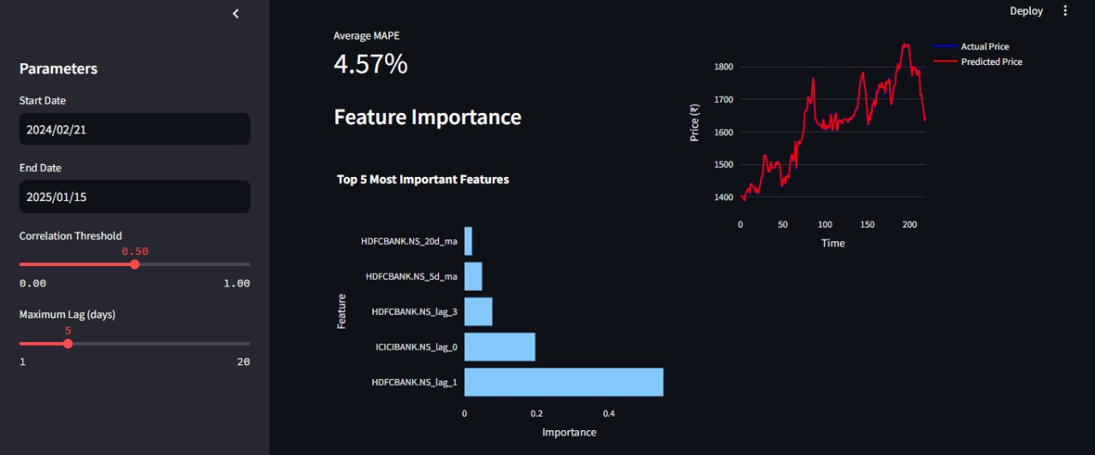

Slide 30
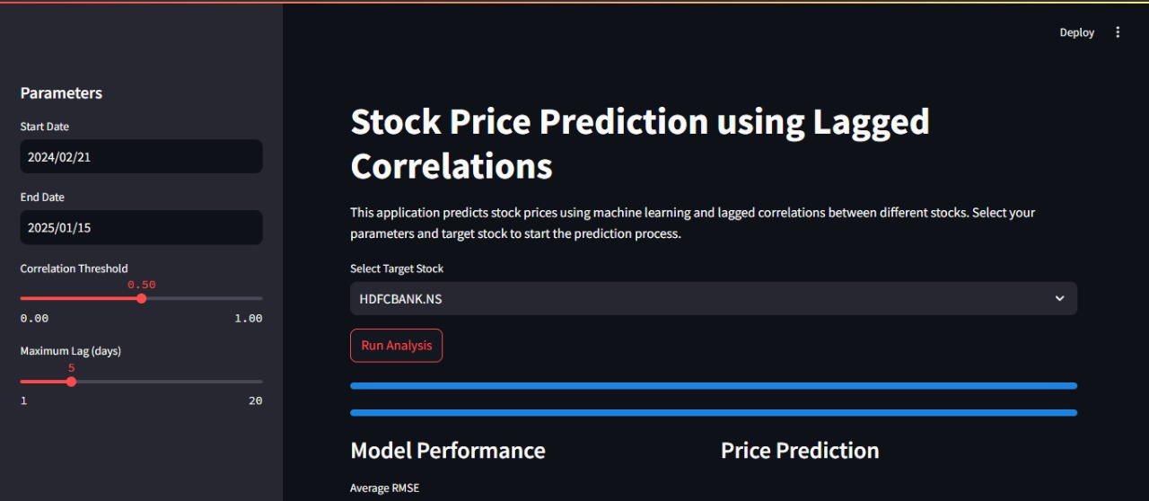

Slide 31
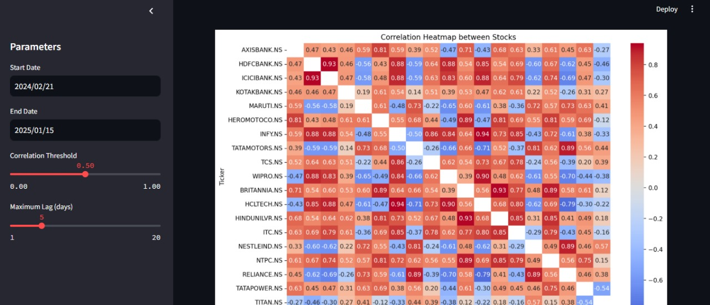

Slide 32
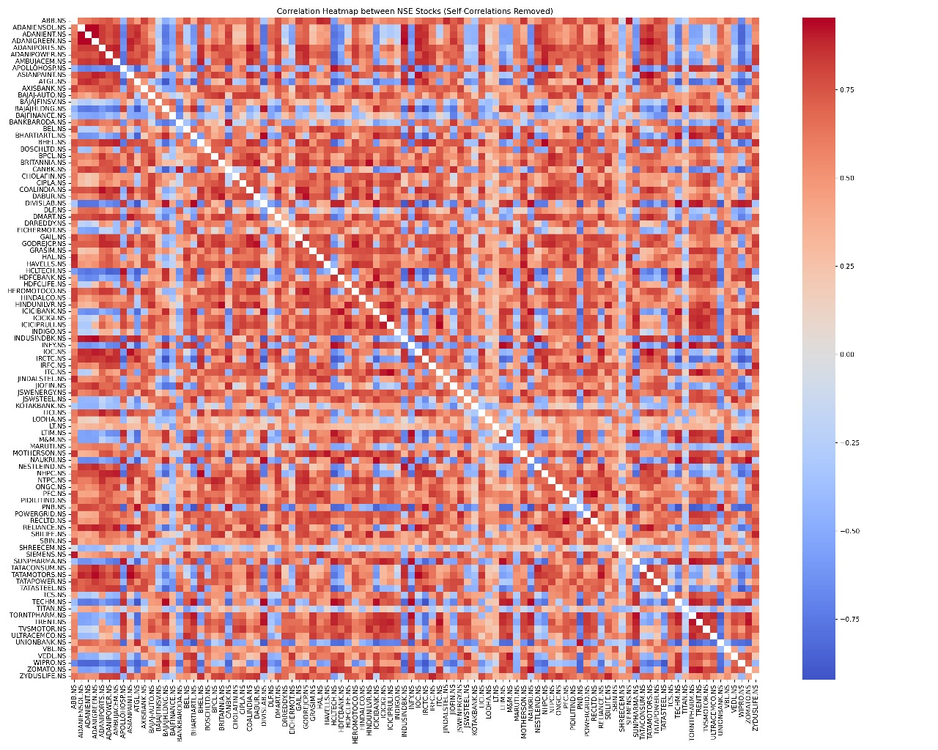

Slide 33
Future Scope
How can this be improved?
• Feature Enhancement: Incorporating macroeconomic indicators and sentiment analysis for more accurate stock price predictions.
• Advanced AI Integration: Implementing deep learning models like LSTM networks to better capture complex market patterns.
• Portfolio Optimization: Extending the system to provide automated investment recommendations based on predicted price movements.

Slide 34
Relevance
Why is this important?
Automation
Optimization
Risk Management
Trend Analysis
Strategy Development
Portfolio Optimization
Anomaly Detection

Slide 35
Conclusion
What did we infer from this?
Robust Stock Prediction Model: The project leverages AI-driven techniques to analyze lagged correlations among stock prices, improving forecasting accuracy.
Enhanced Financial Decision-Making: By integrating machine learning models, it provides investors with data-driven insights, aiding in risk assessment and strategic investments.
Scalable and Reliable System: The framework ensures adaptability to different market conditions, offering a scalable approach to financial analysis and stock trend predictions.

Slide 36
References
Related research works.
[1] https://ieeexplore.ieee.org/document/10735203
[2] https://www.researchgate.net/publication/366442499
[3] https://www.geeksforgeeks.org/xgboost/
[4] https://www.researchgate.net/publication/358396484 3

Slide 37
Thank You

